Slide 1
Employee Attrition
What makes an employee leave their company?

Slide 2
What is Employee Attrition?
Definition : “When an employee leaves the company through any method, including voluntary resignations, layoffs, failure to return from a leave of absence, or even illness or death”
Two types of employee attrition:
Voluntary
Employee deliberately chooses to leave their company
Company has the decision to not replace the employee
Involuntary
The company chooses to let go of (fire) an employee
EX) Reorganization, layoffs
In this case, the company either eliminates the employee’s position altogether or chooses not to replace it
https://www.digitalhrtech.com/employee-attrition/

Slide 3
Issues with Voluntary Employee Attrition
Lack of continuity and consistency within organization and within teams
Training gaps
Lack of institutional knowledge
Higher recruiting efforts, longer recruiting time
Empty positions can be left for some time; leaves teams understaffed
Possible burnout for remaining employees -- overloaded and overworked
Increase in recruiting, hiring and training costs

Slide 4
Statistical Question: What factors play a significant role in predicting voluntary employee attrition?

Slide 5
As a current employee at a company, I have started to take note of what motivates and what deters other employees. Many things play into people’s decisions to leave a company, and it is intriguing to me to understand what causes movement in the workplace and also how companies can ideally increase their employee retention at the end of the day.

Slide 6
The Dataset: IBM HR Analytics Employee Attrition & Performance
Employee survey from IBM, a technology corporation
Gathered information around employee satisfaction, income, job level and some personal demographic data such as age and gender
Dataset structure:
1470 rows of data
35 columns
Each record in the dataset pertains to an employee that is either currently at IBM or voluntarily left
Attrition = ‘Yes’ or ‘No’
https://www.kaggle.com/pavansubhasht/ibm-hr-analytics-attrition-dataset

Slide 7

Variables Deemed Relevant to The Statistical Question from Personal Observations

Slide 8
Variable Histograms

Slide 9
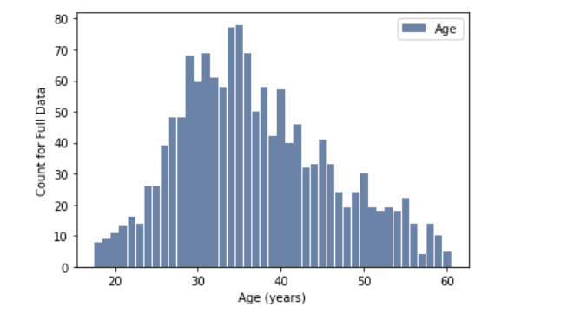
Histogram of Age
The distribution of age for the entire dataset is relatively left-skewed. From looking at the histogram, it looks like there are outliers from age 18- ~21. Those ages are quite young for employees at a company, as usually companies hire people with undergraduate degrees and most people graduate from college at age 22 or 23. I am going to remove this population from the dataset to more align with the dataset with normal working ages at a company.

Slide 10
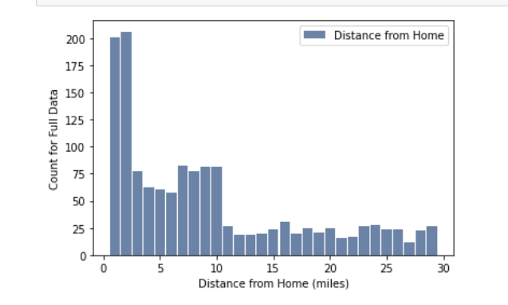
Histogram of Distance From Home
- Left-skewed distribution
- The IBM office for most employees is relatively close to their homes, less than ~3 miles
- With any company, it is standard for employees to have different commuting distances given the office location

Slide 11
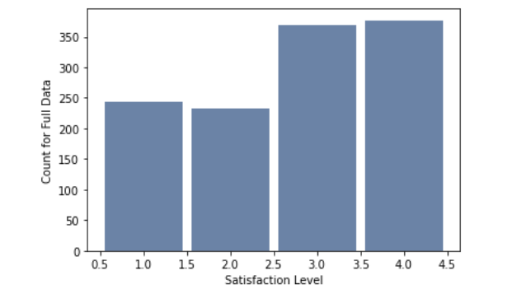
Histogram of Job Satisfaction
- Most people are relatively satisfied with their jobs
- Difficult to detect an outlier among only 4 possible values

Slide 12
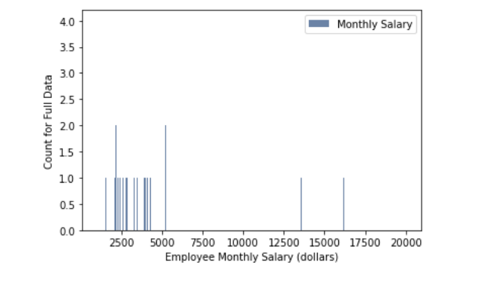
Histogram of Monthly Income
From the distributions of monthly income and yearly income, it is apparent that there are outlier values for salaries above 100,000 dollars. Depending on your job level and field, this salary range of above $100,000 can be attainable, but I think even with the outliers, salary plays a key role in determining if employees stay at a company. Therefore, I will not remove this subset.
The distributions for monthly income and yearly income for the entire dataset are the same, which makes sense as yearly income is calculated from the monthly incomes.

Slide 13
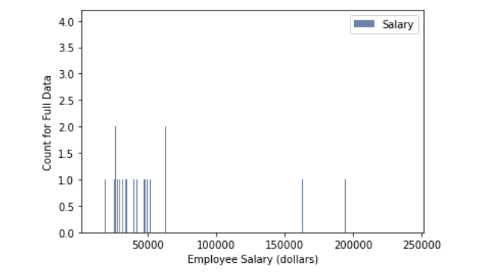
Histogram of Yearly Income (calculated field)

Slide 14
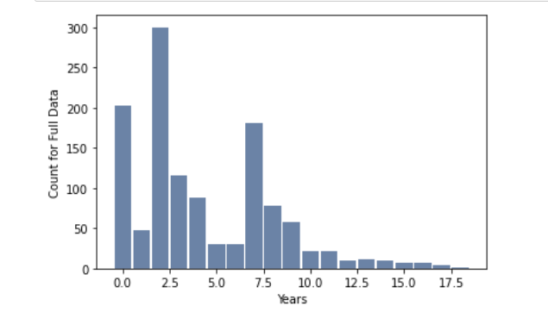
Histogram of Years in Current Role

Slide 15
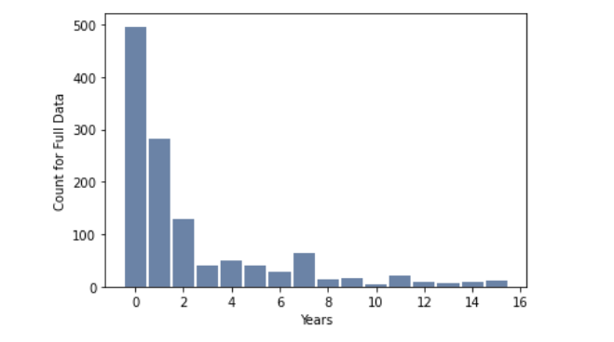
Histogram of Years Since Last Promotion

Slide 16
Analysis of Year Field Histograms
When looking at the years variables, it is tough to say if any entries are outliers, since employees often do and are even supposed to have varying years of experience at a company and within their career. At my company, there are employees with 35+ years, while I have less than a year, so I wouldn't say any of these outliers above the top of the boxplots are out of the ordinary or need to be removed.

Slide 17
Descriptive Characteristics

Slide 18
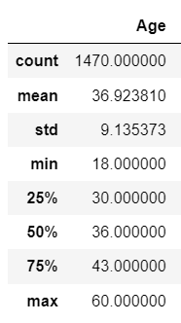
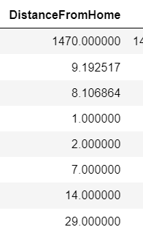
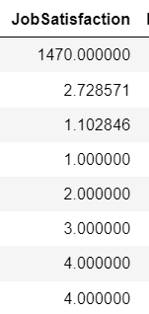
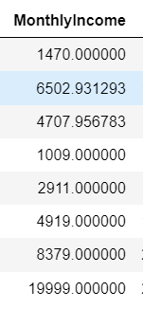
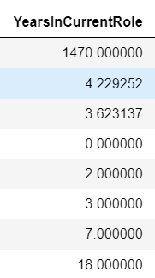
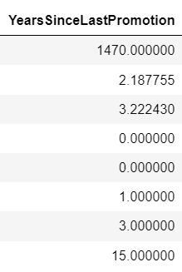
Mean, Mode, Spread and Tails

Slide 19
Comparing Two Scenarios Using a PMF
Scenario: An employee participates in voluntary attrition or the employee does not participate in voluntary attrition
Variable: Years Since Last Promotion

Slide 20
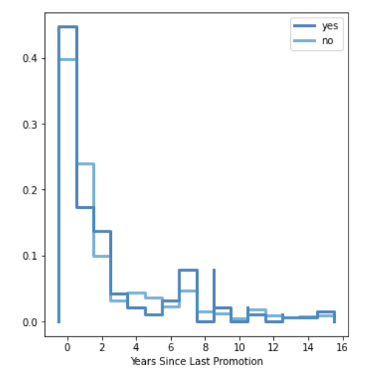
The "yes" population goes back and forth among the distribution plot in comparison to the "no" group, there are many fluctuations in probability in terms of Yearly Income.
In trying to find a general pattern, the "yes" group seems to be more likely to have fewer years since their last promotion than the "no" group, which would signify that they are recently in newer positions which could increase work pressure and stress. However, at the greater end of the year scale, the "yes" group is also slightly more likely than the "no" to have those years since their last promotion, which would be quite a long time for someone to be at the same job level, which can be a reason for job movement.
Therefore, this variable is not really helpful in showing how it plays into employee attrition.

Slide 21
CDF of Age

Slide 22
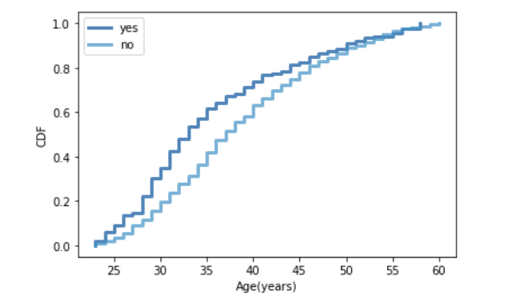
From looking at the CDFs for Age in terms of 'yes' or 'no' employee attrition, they have more spread from about ages 25-45, which is when the employees who left the company were more likely to be those ages or younger than the "no" group or the employees who chose at the stay company. Therefore, this could show for that age range that it's a more popular time for employees to choose to leave a company, which would make sense given that it's a defining time in people's lives and people are told to explore and experiment more in their careers.

Slide 23
Analytical Distribution - Normal

Slide 24
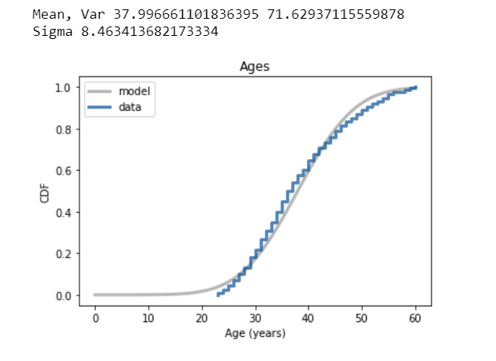
Below the 10th percentile, there is a discrepancy between the data and the model; there are less young employees than we would expect in a normal distributions. However, this is due to the removal of the younger employees (< age 18) from the dataset, because I considered them to be outliers and just not relevant to a dataset regarding full-time employees choosing whether to leave a company.
Since I am not specifically interested in employees less than the age of ~23, then I am not incredibly disappointed by the use of the normal model for this data/variable.

Slide 25
Scatter Plots Between Two Variables - Correlation & Causation

Slide 26
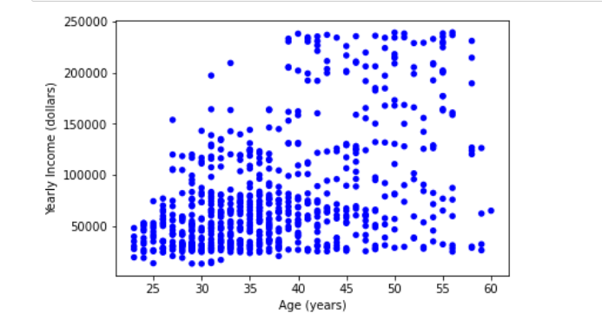
Scatter

Slide 27
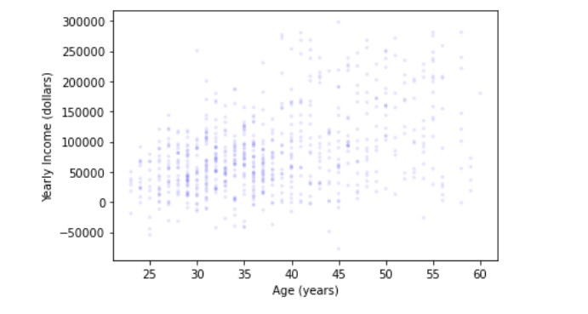
Jitter

Slide 28

Analysis of Scatter Plots
From initial exploration of the scatter plot between Age and Yearly Income (Salary), there appears to be a positive relationship meaning as the age of an employee increases, their yearly income increases as well (i.e. they start to make more money). The relationship also appears to be linear, as it doesn't seem like any other specific function would fit to the data better than a straight line.
The correlation of Age & Yearly Income (salary) is about 0.47, which is a moderately positive correlation.

Slide 29
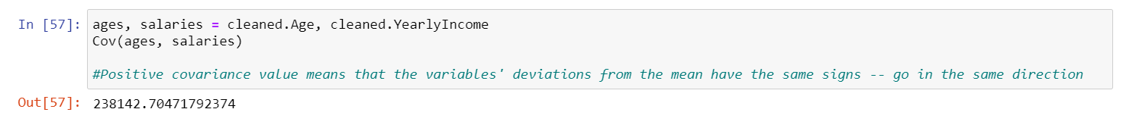
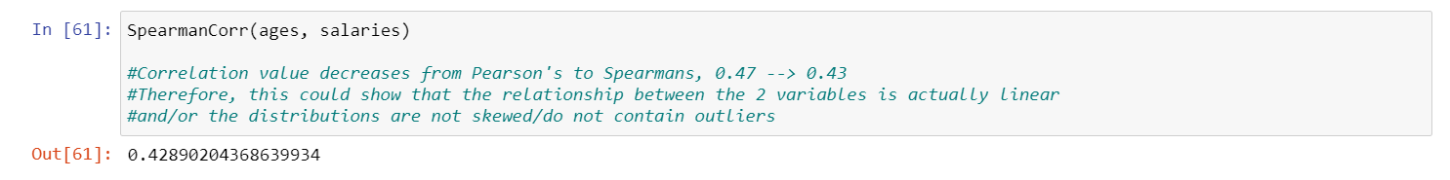
Covariance & Spearman’s Rank

Slide 30
Assessment of Correlation vs. Causation
In terms of the relationship between Age & Yearly Income, even though we witnessed a positive relationship between the two variables, I definitely think there other factors that cause both Age and Salary, such as years of experience, role at a company, etc. An employee's salary is highly dependent on many factors about an individual and their work performance, but age definitely does have an impact since it aligns with knowledge and expertise and years that one is actually able to work.

Slide 31
Hypothesis Testing
I want to investigate/test the difference in mean yearly income (salary) that we see between the employees that left the company and the employees that stayed.
I want to know if that effect reflects a real difference for employees in the U.S., or if it might appear in the sample by chance.

Slide 32
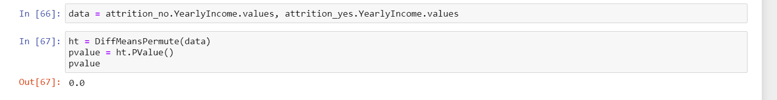
The p-value is equal to 0.0, which is less than both of the statistically significant values of 0.05 and 0.01, which means that it is plausible that the observed difference in mean yearly income is not just the result of random sampling. We could generalize it to the population.

Slide 33
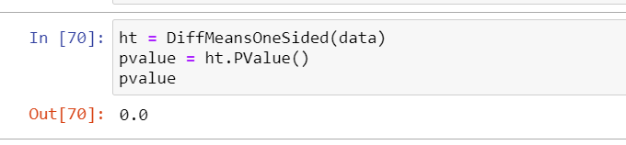
I would expect that the mean yearly income for people in the non-attrition group is higher than the mean yearly income for people in the attrition group, since I expect people to leave their job in order to make more money somewhere else. Therefore, we can also conduct a one-sided hypothesis test for these means.
The p-value result is still statistically significant for the one-sided hypothesis that attrition_yes' mean yearly income will be greater than attrition_no's mean yearly income. Therefore, we can also conclude at p = 0, that the observed one-sided difference could also be generalized to the population and not just our sample of IBM employees.

Slide 34
Regression Analysis (Logistic)

Slide 35
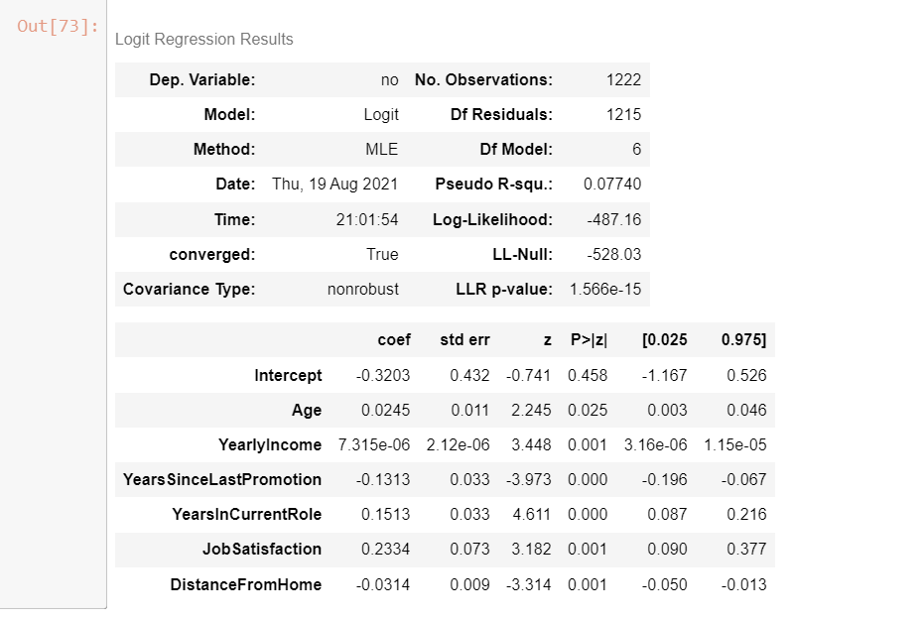
All variables chosen for exploration were included in the regression … Age, Yearly Income, Years Since Last Promotion, Years in Current Role, Job Satisfaction and Distance From Home

Slide 36
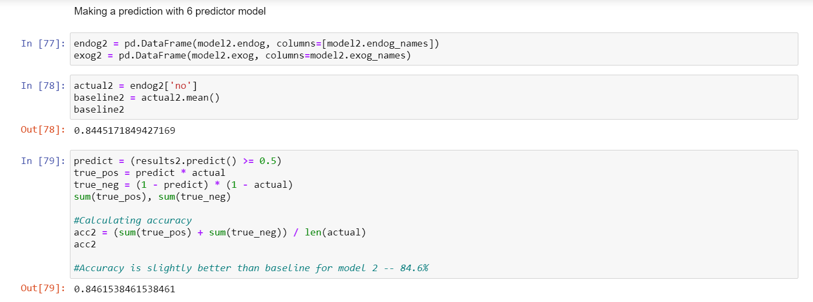
Logistic Regression - Attrition as the dependent variable (Binary: Yes or No)

Slide 37
Thank you so much! I am incredibly sorry again.

